Slide 1
Information and Electronic Integration Practice
劉泰佑 – C100E030

Slide 2
Net Connection
Today’s Lesson

Slide 3

What do we need?
Visual Studio 2022
Computer
Arduino
Arduino IDE

Slide 4
About this project
So in this project we will try to replicate the server and client function but only using the local machine and only using two Visual Studio Program. The first program will act as the server and the other one will act as the client.
We also try to implemented some data from Arduino into this process, so that the client will also send some temperature and humidity data.
For the Arduino we will only use the DHT22 sensor to measure the temperature and humidity, and send it into our machine which later can be shown in the visual studio client program when running.

Slide 5
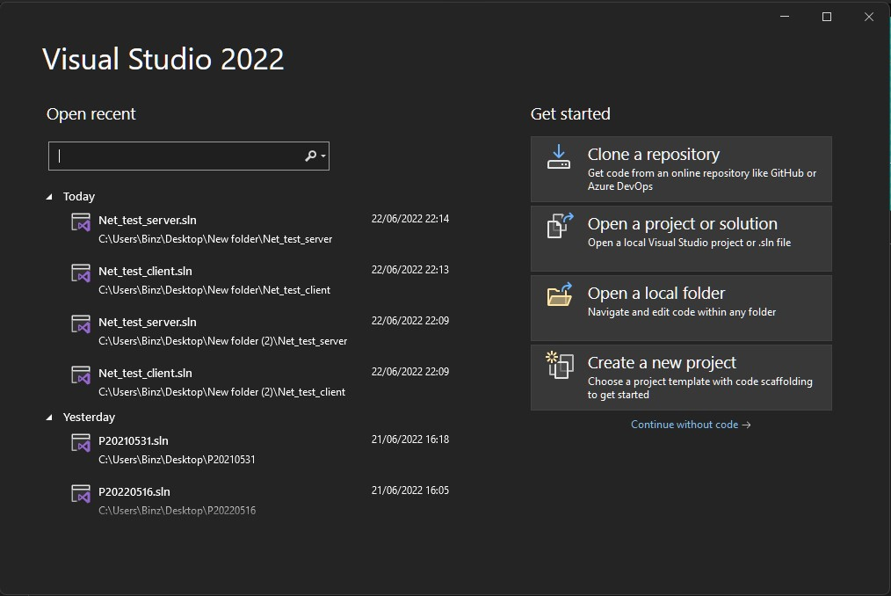
#1 Step
First open the visual studio app and create new project

Slide 6
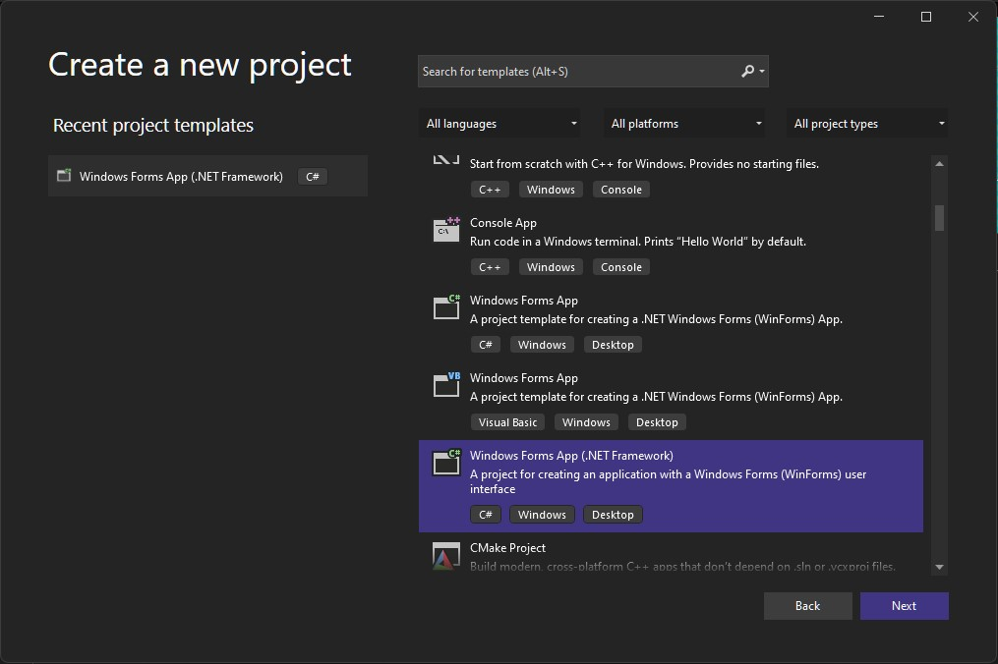
#2 Step
Next select the “Windows Forms App (.NET Framework)

Slide 7
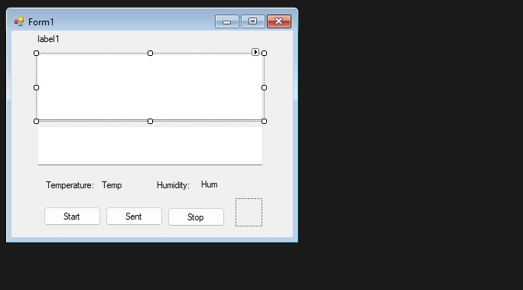
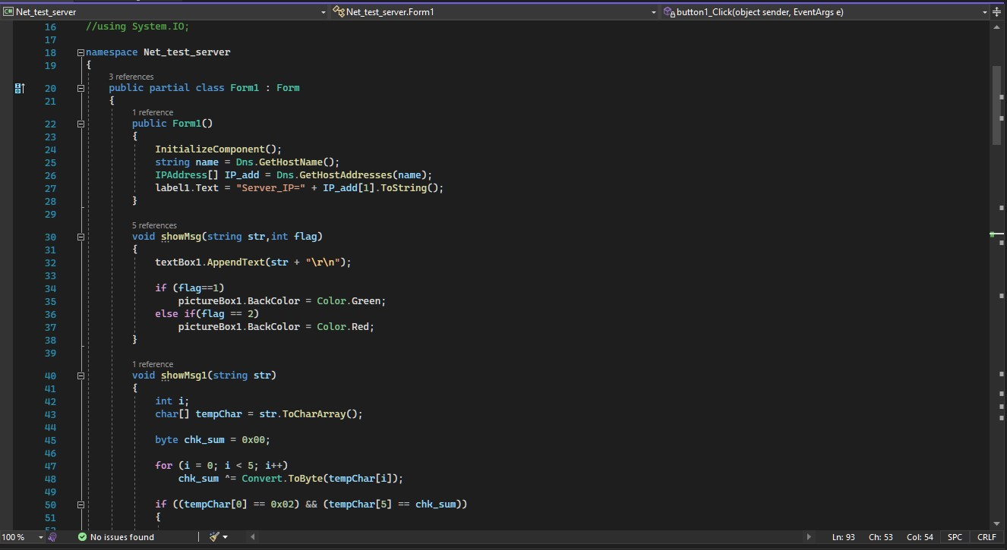
#3 Step
Components :
TextBox x2
Button x3
Label x5
PictureBox x1
Prepare the design and the code for the server program

Slide 8
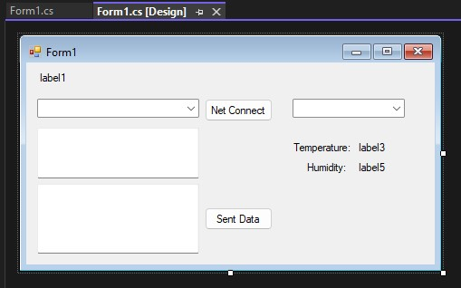
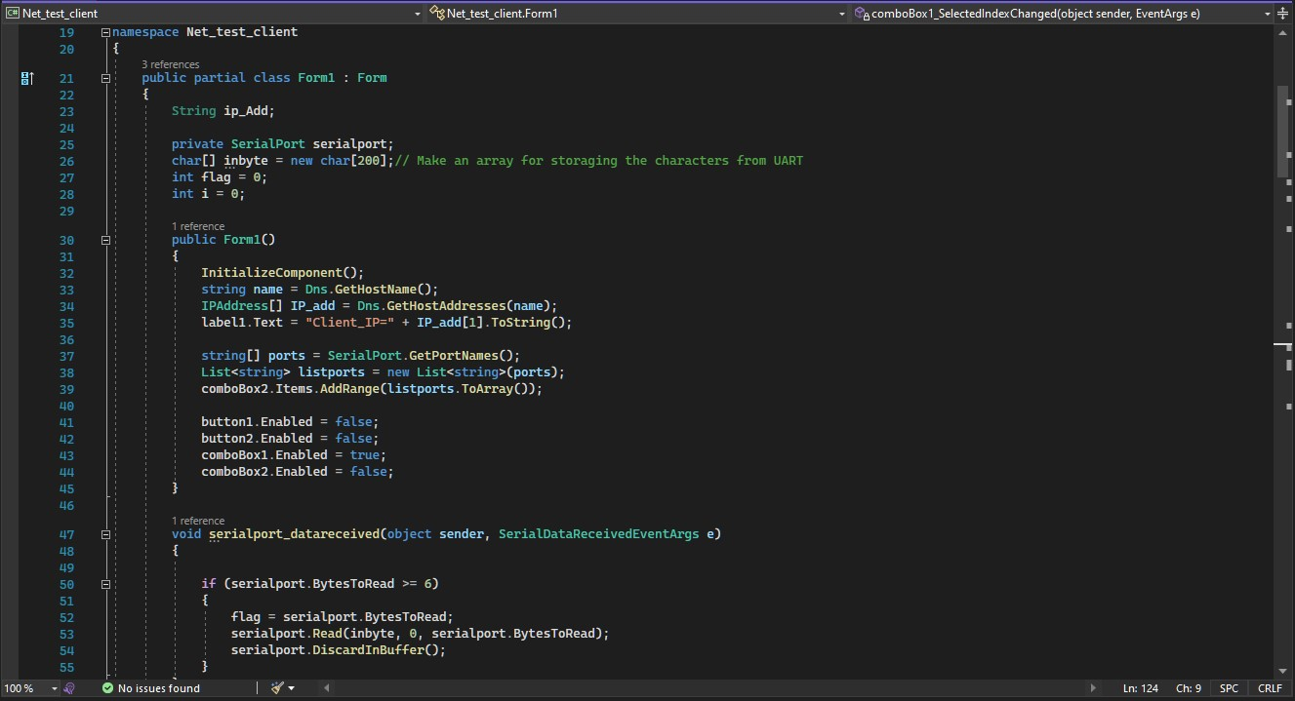
#4 Step
Components :
TextBox x2
Button x2
Label x5
ComboBox x2
Timer x1
Prepare the design and the code for the client program

Slide 9
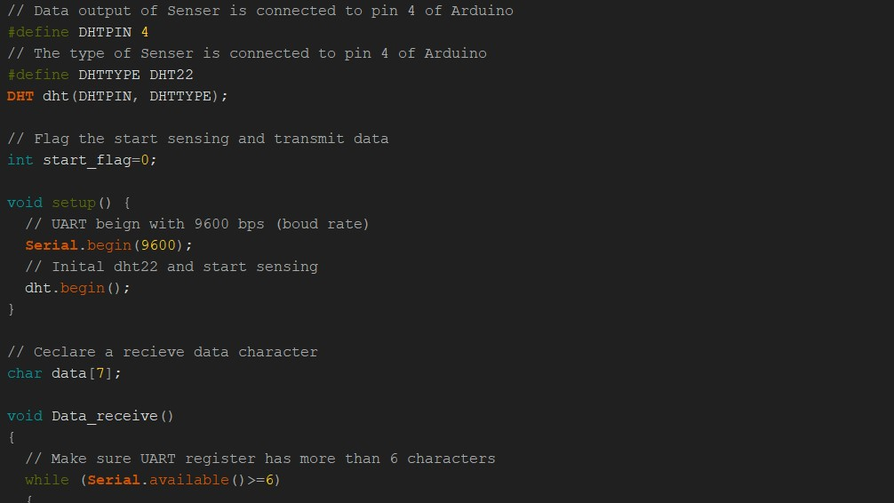
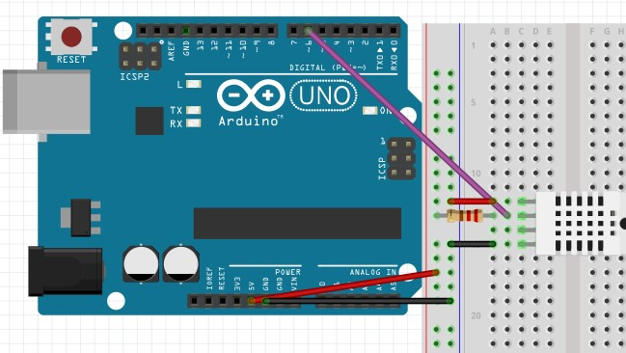
#5 Step
Prepare the Arduino device connected into the DHT22 sensor and the program in Arduino IDE

Slide 10
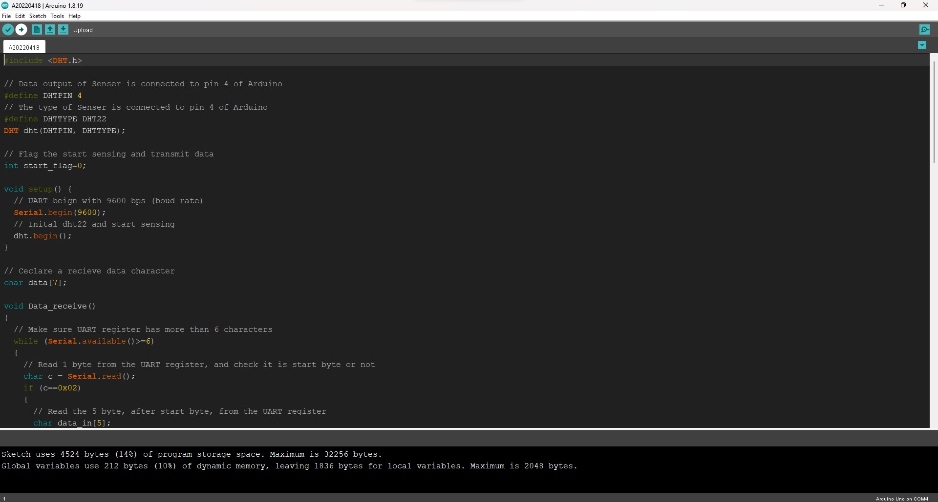
#6 Step
After all program and device ready, then we just need to run the program. First lets run the Arduino program

Slide 11
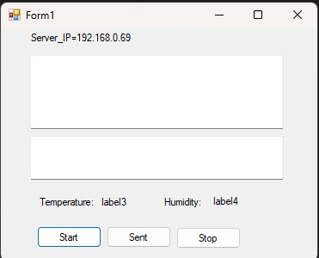
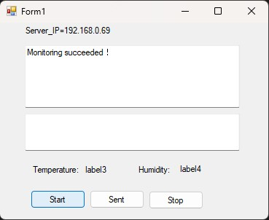
#7 Step
Run the server program and click the start button

Slide 12
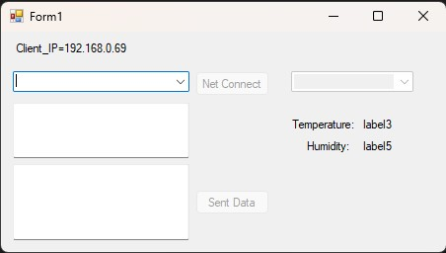
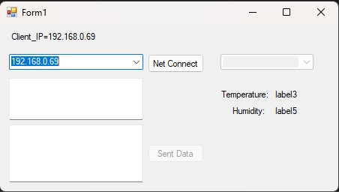
#8 Step
Now let’s run the client program and select our computer ip address

Slide 13
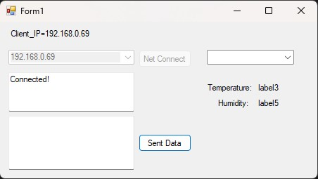
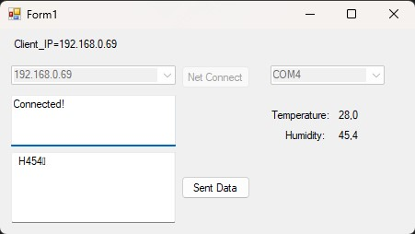
#9 Step
Now in the client program press the connect button and select the right port to your Arduino device

Slide 14
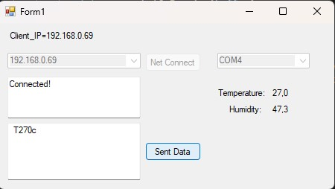
#10 Step
Now you in your client program it should show you the temperature and humidity data, now try to press the sent button and check id the server program receive the data from the client program

Slide 15
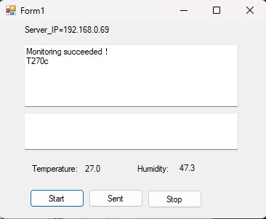
#11 Step
Now your server program should receive the temperature and humidity data that have been sent from the client program

Slide 16

And We Are Done!
We finally successfully finish creating the program!

